Slide 1
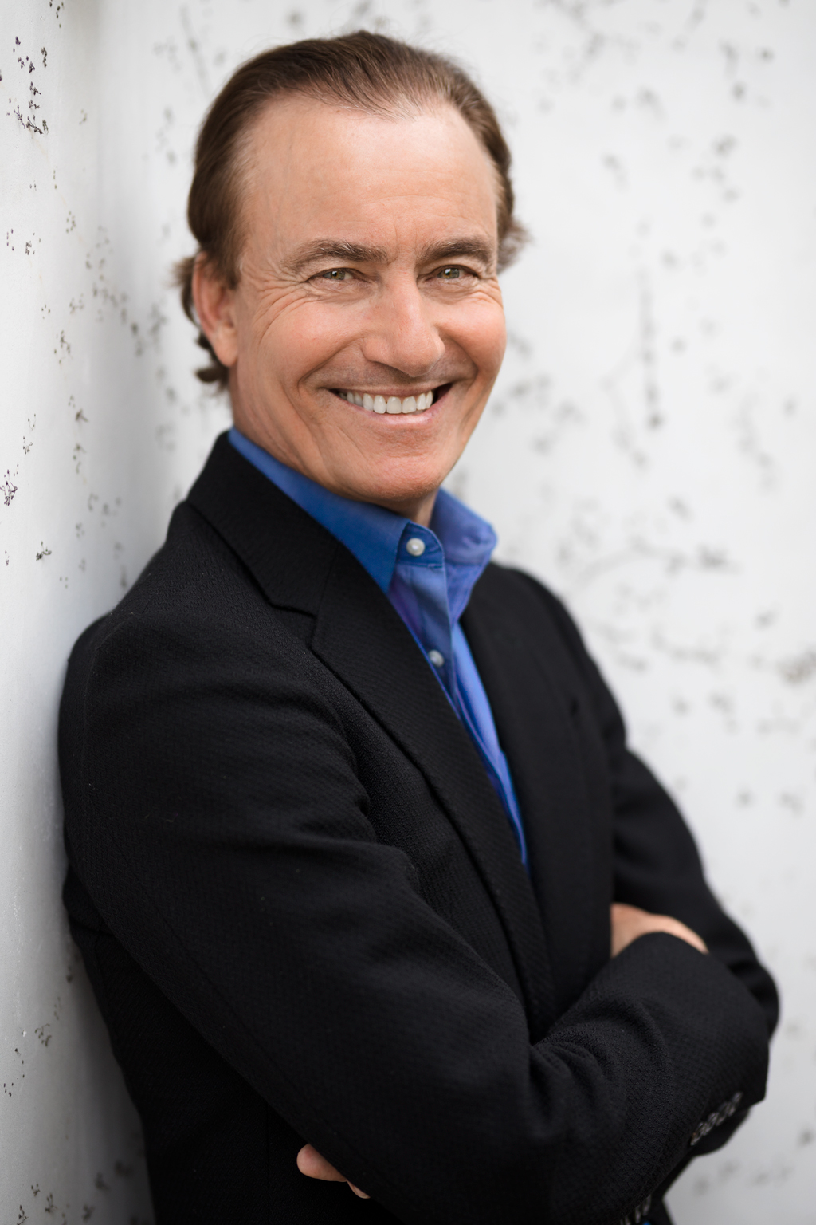
William Murray “Trip” Hawkins III
Created by : Ciobanu Stanislav, student of
the faculty of Mathematics and Informatics
Group : I2302

Slide 2
Questions
What is he famous for?
What companies were founded by Trip Hawkins?
What universities did he graduate?
Where he had worked before he started a solo career?
How much money did he borrow from his father?

Slide 3
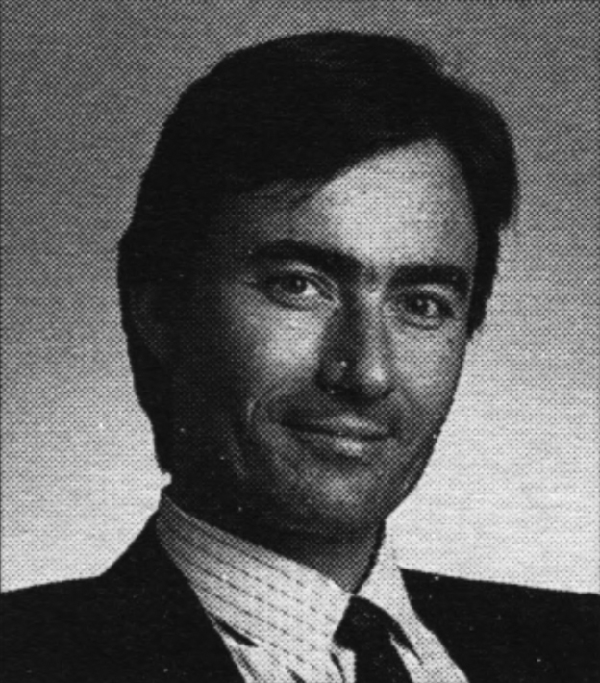
Origin
William Murray “Trip” Hawkins III was born December 28, 1953 (Is 69 now) in Pasadena California, U.S.
Brought up in California, Trip Hawkins had a very bright and creative childhood. Both of his parents were equally artistic. Though his father was a part of the growing electronics industry, he later delved into becoming an artist. His mother was a great musician and also wrote poems. Maybe the creative family background of Trip gave him the idea of designing everything of his own.
Trip graduated University of Harvard and University of Stanford.
Trip Hawkins in 1987

Slide 4
Start of the career
It was in the 1960s when Trip started playing simulation board games. He played many games but his favorite one was Strat-O-Matic. He became addicted to the game and more than that he was keen about how it is working. The designing part intrigued him and led him to build his own game of a similar type. It was in 1973 that he builds the gaming but failed to sell enough copies of it. Eventually, he received his first computer and became interested in creating a digital football game, because it would allow players to avoid the challenging math of the game were all handled internally.

Slide 5

Apple computer
Before founding Electronic Arts, Trip worked at Apple as a Director of Strategy and Marketing. But, his planning didn’t stop and it took him eleven years for implementing it. The trip also did an MBA because he was interested in the business market equally. But, he noticed nobody in Apple wasn’t really a gaming enthusiast.
A gaming Pro with a business degree thus left Apple after working for four years. But, Trip admits that working closely with Steve Jobs helped him a lot in building his own empire.

Slide 6

Electronic arts
In January 1982, Trip approached Don Valentine, a Silicon Valley Venture Capitalist. He offered Trip office space and he finally accepted it. When Trip established the company he named it Amazin’ Software which was later renamed Electronic Arts. When Trip founded the company he invested $200,000 from his own pocket.
Electronic Arts are headquartered in Redwood City, California. Today, it is known as the second-largest gaming company in the American and European markets in terms of revenue and market capitalization. In 2018, the company’s annual revenue summed up to $5.15 billion. There are almost 9,000 employees working for the company.

Slide 7
Life after Electronic arts
In 1991, Trip formed 3DO, a video game console company. After a couple of years, it became the most powerful video game console. In 1996, 3DO became a video game developer. As an example, original Might and Magic games were released by 3DO, but it went out of business in 2003.
But, Trip didn’t give up that easily. In late 2003, he came up with a new video game development company, Digital Chocolate. In 2012, Trip resigned from the company and joined the board of directors of Extreme Reality.

Slide 8
Interesting facts
In 1973 Trip Hawkins borrowed $5,000 from his father to start up.
Trip went to Harvard University and there he designed his own course for studying game theory.
In 2005, Trip became the eighth person to get enrolled in the Academy of Interactive Arts and Science Hall of Fame.

Slide 9
Links and sources
https://en.wikipedia.org/wiki/Trip_Hawkins
https://triphawkins.com
https://www.yourtechstory.com/2020/01/20/trip-hawkins-founder-of-electronic-arts-and-other-gaming-industries/
https://computerhistory.org/profile/trip-hawkins/

Slide 10
Glossary
Brought up – Воспитанный, выросший
To estimate – Оценить
Entrepreneur - Предприниматель
To borrow – Занять
Resign – Уйти в отставку

Slide 11
Outro
In my opinion Trip Hawkins was a kind of Gentlemen of luck. He was a cool entrepreneur and during the whole life he was trying to create something. He was moving from one company to another project and didn’t stay there for long.
Now Trip Hawkins lives in Santa Barbara (California) where he served as a professor of entrepreneurship and leadership. He is 69 years old. His marriage with Lisa Proctor Hawkins caused bright of 4 children.

